Slide 1
Համակարգային Ծրագրավորում
Կուրսային աշխատանք
Տիգրան Խաչատրյան
2017 2-րդ կիսամյակ

Slide 2
Վիրտուալություն
Virtual Machine Ln (Software)
…
Virtual Machine L1 (Software)
Actual Machine L0 (Hardware)

Slide 3

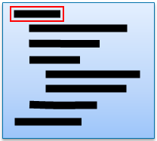
Կոմպիլյացիա և Ինտերպրետացիա
Compilation
Source Code:
Translation
Compilation
Linking
Executable Program
Interpretation
Source Code:
Statement Interpretation
Execution
Next Statement

Slide 4
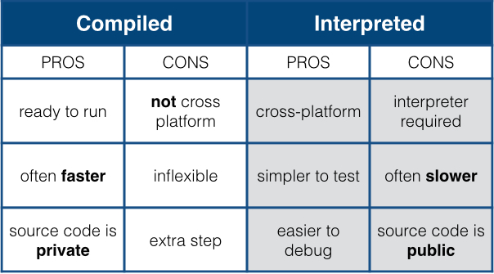
Կոմպիլյացիա և Ինտերպրետացիա

Slide 5
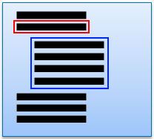
Ժամանակակից Ինտերպրետատորներ
Mixing Compilation & Interpretation
Source Code:
Runtime
(JRE, CLR)
Execution
JIT
Byte Code:
Translation
Compilation
Native Code

Slide 6
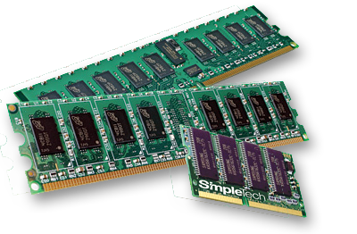
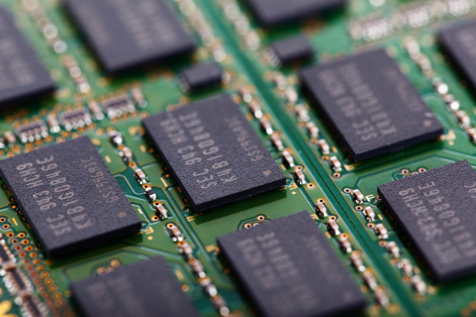
Հիշողություն Computer Memory
Երկուական (1 Bit = 0 | 1)
Միավոր (Byte = 8 Bit)
Շարունակական զանգված
Հասցեավորում և հասցեական տարածություն (Address space, 2³²)
Մեքենայական բառ (Register = 2, 4 Byte)
0x0000
0x0004
0x0008
0x000C
0x0010
…
0xFFFC

Slide 7
32Bit Architecture Instruction Format
Control Registers
Hidden Registers
FLAGS : 32
IR : 32
(extension) : 32
Address Registers
General Purpose Registers
R0 : 8
IP (PC) : 32
A1 : 32
R1 : 8
Register pool
(1024 Byte)
TR : 32
A2 : 32
R2 : 8
SP : 32
A3 : 32
…
SF : 32
A4 : 32
R1024 : 8
IR = Instruction Register
IP = Instruction Pointer
(PC = Program Counter)
SP = Stack Pointer
SF = Stack Frame
TR = Task Register
ZERO (NULL) : 32 (RO)

Slide 8
FLAGS
31
19
18
17
16
7
6
5
4
3
2
1
0
NT
AF
PF
CF
TF
PE
Reserved
AC
CPL
IF
Reserved
DF
OF
SF
ZF
TF: Trap Bit
CF: Carry Flag
PF: Parity Flag
AF: Adjust Flag
ZF: Zero Flag
SF: Sign Flag
OF: Overflow Flag
DF: Direction Flag
IF: Interrupt enable Flag
CPL: Privilege Level
AC: Alignment Check
NT: Nested Task
PE: Protection Enable Flag
Carry Flag. Set if an arithmetic operation generates a carry or a borrow out of the most-significant bit of the result; cleared otherwise. This flag indicates an overflow condition for unsigned-integer arithmetic. It is also used in multiple-precision arithmetic.
Parity flag. Set if the least-significant byte of the result contains an even number of 1 bits; cleared otherwise.
Adjust flag. Set if an arithmetic operation generates a carry or a borrow out of bit 3 of the result; cleared otherwise. This flag is used in binarycoded decimal (BCD) arithmetic.
Zero flag. Set if the result is zero; cleared otherwise.
Sign flag. Set equal to the most-significant bit of the result, which is the sign bit of a signed integer. (0 indicates a positive value and 1 indicates a negative value.)
Overflow flag. Set if the integer result is too large a positive number or too small a negative number (excluding the sign-bit) to fit in the destination operand; cleared otherwise. This flag indicates an overflow condition for signed-integer (two’s complement) arithmetic.

Slide 9
32Bit Architecture Instruction Format
2 Byte:
OpCode
0
16
4 Byte:
OpCode
R
0
16
32
6 Byte:
OpCode
R trgt.
R src.
0
16
32
48
8 Byte:
OpCode
R trgt.
R src.1
R src.2
0
16
32
48
64
4/6 Byte:
OpCode
Immediate
(extension)
0
16
32
48
6/8 Byte:
OpCode
R
Immediate
(extension)
0
16
32
48
64

Slide 10
Instruction Set Control Instructions
Conditional Instructions
JE / JZ (zf=1)
JNE / JNZ (zf=0)
JA / JNBE (cf=0 & zf=0)
JAE / JNB (cf=0)
JB / JNAE (cf=1)
JBE / JNA (cf=1 | zf=1)
JG / JNLE (zf=0 & sf=of)
JGE / JNL (sf=of)
JL / JNGE (sf<>of)
JLE / JNG (zf=1 | sf<>of)
JO (of=1)
JNO (of=0)
JS (sf=1)
JNS (sf=0)
JP (pf=1)
JNP (pf=1)
NOP (no operation)
BREAK (break point)
INT N
JUMP (abs.) An/Address
JUMP (rel.) Rn/Offset
JUMP cc (rel.) Rn/Offset
CALL (abs.) An/Address
CALL (rel.) Rn/Offset
RET
IRET
STI/CLI (set/clear IF)
STC/CLC (set/clear CF)

Slide 11
Instruction Set
Assignment
ASSIGN Rn ← Value (1,2,4,8 byte)
ASSIGN An ← Address (4 byte)
Move Across Registers
MOVE Rn ← Rn (1,2,4,8 byte)
MOVE An ← Rn (4 byte)
MOVE Rn ← An (4 byte)
MOVE cc Rn ← Rn (1,2,4,8 byte)
MOVE cc An ← Rn (4 byte)
SWAP Rn ↔ Rn (1,2,4,8 byte)
SWAP An ↔ An (4 byte)
SWAP cc Rn ↔ Rn (1,2,4,8 byte)

Slide 12
Instruction Set
Logical (bitwise)
AND Rn, Rn → Rn (1,2,4,8 byte)
OR Rn, Rn → Rn (1,2,4,8 byte)
XOR Rn, Rn → Rn (1,2,4,8 byte)
NAND Rn, Rn → Rn (1,2,4,8 byte)
NOR Rn, Rn → Rn (1,2,4,8 byte)
NOT Rn (1,2,4,8 byte)
SHR/SAR Rn, Rn/N (1,2,4,8 byte)
SHL/SAL Rn, Rn/N (1,2,4,8 byte)
ROR/RCR Rn, Rn/N (1,2,4,8 byte)
ROL/RCL Rn, Rn/N (1,2,4,8 byte)
Comparison
TEST Rn, Rn (1,2,4,8 byte)
TEST An, An (8 byte)
TEST An, Rn (8 byte)
TEST Rn, An (8 byte)

Slide 13
Instruction Set
Integral Arithmetic
ADD Rn, Rn → Rn (1,2,4,8 byte)
ADC Rn, Rn → Rn (1,2,4,8 byte)
SUB Rn, Rn → Rn (1,2,4,8 byte)
SBB Rn, Rn → Rn (1,2,4,8 byte)
MUL Rn, Rn → Rn (1,2,4,8 byte)
IMUL Rn, Rn → Rn (1,2,4,8 byte)
DIV Rn, Rn → Rn (1,2,4,8 byte)
IDIV Rn, Rn → Rn (1,2,4,8 byte)
INC/DEC Rn (1,2,4,8 byte)
INC/DEC An by Rn (8 byte)
NEG Rn (1,2,4,8 byte)
Comparison
CMP Rn, Rn (1,2,4,8 byte)
CMP An, An (8 byte)
CMP An, Rn (8 byte)
CMP Rn, An (8 byte)

Slide 14
Instruction Set Memory Access
LOAD Rn ← [An] (1,2,4,8 byte)
LOAD An ← [An] (8 byte)
STORE Rn → [An] (1,2,4,8 byte)
STORE An → [An] (8 byte)
LOAD (rel.) Rn ← [An±Rn/N] (1,2,4,8 byte)
LOAD (rel.) An ← [An±Rn/N] (8 byte)
STORE (rel.) Rn → [An±Rn/N] (1,2,4,8 byte)
STORE (rel.) An → [An±Rn/N] (8 byte)

Slide 15
Instruction Set Stack
1 byte
PUSH Rn (1,2,4,8,… byte)
POP Rn (1,2,4,8,…byte)
PUSH An (8 byte)
POP An (8 byte)
PUSHF / POPF
PUSH SF / POP SF
0x00000000
Stack
SP (TOP)
1,2,4,8, … bytes
Data
PUSH
SP = SP – N (1,2,4,…)
[SP] = R (1,2,4,… byte)
0xFFFFFFFF
POP
R = [SP] (1,2,4,…byte)
SP = SP + N (1,2,4,…)

Slide 16
Instruction Set Stack
PUSH Rn (1,2,4,8,… byte)
POP Rn (1,2,4,8,…byte)
PUSH An (8 byte)
POP An (8 byte)
PUSHF / POPF
PUSH SF / POP SF
1 byte
0x00000000
Stack
SP (Top)
Previous SF
SF (Base)
PUSH SF
SP = SP - 8
[SP] = SF
SF= SP
POP SF
SP = SF
SF = [SP]
SP += 8
0xFFFFFFFF

Slide 17
Instruction Set I/O (External Devices)
IN Rn ← Port [N] (1,2,4,8,… byte)
IN Rn ← Port [Rn] (1,2,4,8,… byte)
OUT Rn → Port [N] (1,2,4,8,… byte)
OUT Rn → Port [Rn] (1,2,4,8,… byte)
I/O Port Address Space
0x0001
0xFFFF
0x0000
0x0002
0x0004
…
0x0005
Device 1
Device 2
Device N

Slide 18
Instruction Set
FPU Instructions …
SSE Instruction …
String Instructions …
Cache control Instructions …
Branch Prediction Instructions …
System Instructions (protected) …
Debug Instructions …
Other Instructions…

Slide 19
Starting Computer
Init:
IP = 0xFFFFFFFE
FLAGS = 0x00000
R0…R1024 = 0
A1…A4 = 0
…
Fetch: IR = [IP]
Decode:
Switch (OpCode)
IP += CmdLen
Execute

Slide 20
Execution Transfer
1 byte
JUMP Address
IP = Address
0x00000000
Code
IP
JUMP Offset
IP += Offset
JUMP
JUMP CC Offset
IF (CC)
IP += Offset
Address
0xFFFFFFFF

Slide 21
Function Call
CALL Address
PUSH IP
PUSH SF
IP = Address
SF = SP
CALL Offset
PUSH IP
PUSH SF
IP += Offset
SF = SP
RET
POP SF
POP IP
1 byte
1 byte
0x00000000
Code
0x00000000
Stack
SP (Top)
SF (Base)
IP
Previous SF
CALL
Previous IP
Address
0xFFFFFFFF
RET
0xFFFFFFFF

Slide 22
Hardware Interrupts
Device i
Interrupt
Controller
Signal INT Pin
CPU
Interrupt Request
INT Pin
Device to INT Number Map
INTR (N)
INT Queue
Program Execution
Program
Interrupt Handler
IRET
…

Slide 23
Hardware Interrupts
INT & IF
TRUE
Process Interrupt
FALSE
Fetch
Decode
Inc IP
Execute

Slide 24
CPU Exceptions & Faults
INT & IF
TRUE
Process Interrupt
FALSE
Fetch
Decode
Inc IP
Execute
CPU Handler
Determine Exception Type
Save Root Cause
Restore IP If required

Slide 25
Software Interrupts INT N
INT & IF
FALSE
Process Interrupt
Fetch
Decode
Inc IP
Execute

Slide 26
Interrupt Processing
INT N
PUSH IP
PUSH F
PUSH SF
IP = IVT [N]
IF = 0
SF = SP
Reset INT Pin
Interrupt Vectors
Stack
SP (Top)
SF (Base)
0x00000000
Address 1
Address 2
Backup SF
Address …
Backup Flags
Address N
Backup IP
Address 1
Handler 1
Address 2
Handler 2
Handler …
IRET
POP SF
POP F
POP IP
Address N
Handler N
Program
0xFFFFFFFF

Slide 27
Debugging
Interrupt Vectors
0x00000000
Address 1
Address 2
Address 3
…
Address N
Debugger
When debugger starts, it replaces INT1 & INT3 vectors to point to it’s own handlers then attaches to the target program
Debugger
INT 1 Handler
INT 3 Handler
Program
0xFFFFFFFF

Slide 28
Debugging Break Instruction (Break=Int 3)
Code Before
Code After
Instruction 1
Instruction 1
Instruction 2
Instruction 2
Instruction 3
BREAK
Instruction 4
Instruction 4
…
…
Instruction N
Instruction N
Debugger
At breakpoint saves the command and replaces with BREAK
Address
Instruction 3

Slide 29
Debugging Break Instruction (Break=Int 3)
Code
Debugger
Instruction 1
When execution reaches to the BREAK instruction control passes to debugger
Then it processes the breakpoint and waits to the User
INT 3
Instruction 2
BREAK
Instruction 4
…
Instruction N
Address
Instruction 3

Slide 30
Debugging Break Instruction (Break=Int 3)
Debugger
Code
Debugger restores the instruction and passes control back to the Program with IRET command
IRET
Instruction 1
Instruction 2
Instruction 3
Instruction 4
…
Instruction N
Address
Instruction 3

Slide 31
Debugging Step by Step Trap Bit & INT1
INT & IF
TF
Process INT 1
Fetch
Decode
Inc IP
Execute
FALSE
TRUE

Slide 32
Debugging Step by Step Trap Bit & INT1
Debugger
Code
Step Single Instruction
PUSH Programs SF
PUSH Programs FLAGS
SET TF In pushed FLAGS
Do IRET
Get Control back right after single instruction executed
IRET
Instruction 1
Instruction 2
Instruction 3
Instruction 4
INT 1
…
Instruction N

Slide 33
Assignment
Develop a Interpreter of the computer architecture
It should be a console application
It should read the program written in assembly language in its input
It should Print the state (first instruction and the content of registers) then should wait for the user command
On run single instruction command it should execute single extraction then print the and wait again
On run command it should execute until program ends or breakpoint reached then print the state and wait
It should be possible to view entire program and set/remove breakpoints
It should be possible to view memory content at specified address
It should be possible to restart the program or move instruction point
It should be possible to dump the state of the machine into the file

